Slide 1




Restriction Enzyme Classification
Unsupervised Learning Course Project
Noa Ecker
Ronit Feldman

Slide 2

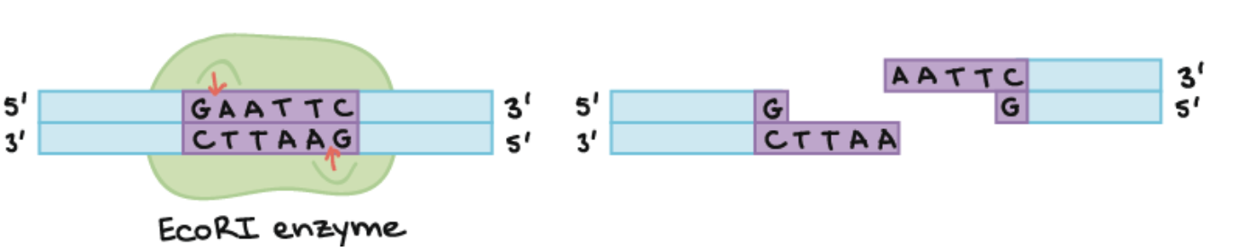
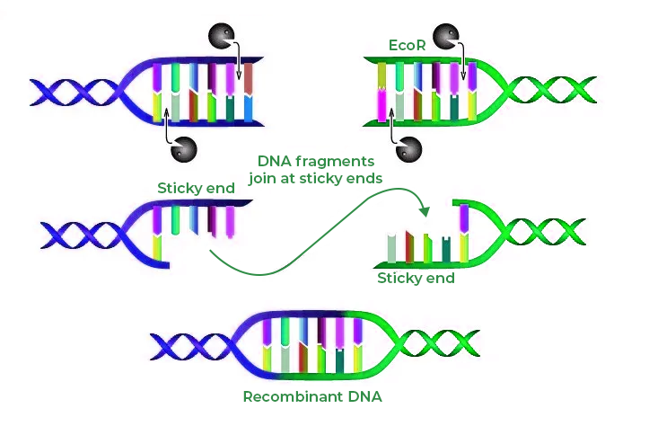
Restriction enzymes

Slide 3



Research question
Can we identify RE based on the sequence?

Slide 4

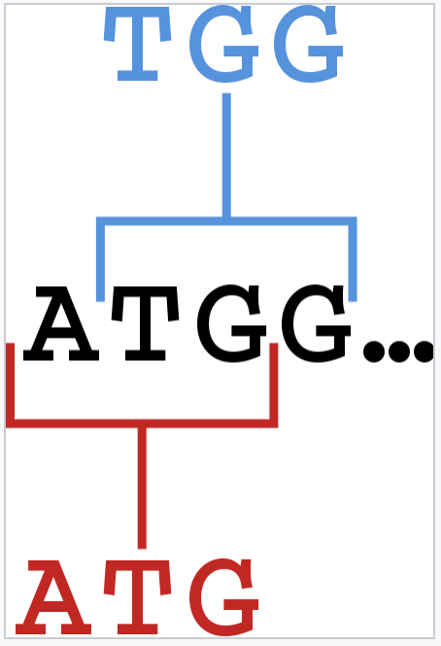
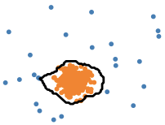
Text classification approach
Data preparation
Stage 1
Stage 2
TF-IDF*
Dimensionality redaction and outlier detection
Stage 3

Slide 5



Normalized TF-IDF
“Text Classification Using Novel Term Weighting
Scheme-Based Improved TF-IDF for Internet Media Reports", Mathematical
Problems in Engineering, vol. 2021”
$$TF−IDF=TF\left(t,d\right)∗IDF(t,d)$$
$$IDF=log\left(\frac{\left|D\right|+1}{DF\left(t,d\right)+1}\right)$$
DF* = $log\left(\frac{DF\left(t,d\right)−mean(DF)}{n}\right)$

Slide 6
Data statistics
243
48
325
Restriction Enzymes
Families
Vocabulary

Slide 7
Best score per algorithm
TF-IDF method | Outlier detection algorithm | FMI index
TF- IDF | Elliptic Envelope | 0.90
AIDF | Elliptic Envelope | 0.88
AIDF+ | Elliptic Envelope | 0.88

Slide 8
THANKS!

